Slide 1
Is selling S&P 500 volatility a free lunch?
ERDŐS INSTITUTE · QUANT FINANCE BOOT CAMP · FALL 2026
Measuring, testing and trading the variance risk premium, 2005–2026
Nahid Hasan Sagar & Team
Notes:
Hi, I’m Nahid Hasan Sagar, an M.S. statistics student at Indiana University. Our project for the Erdős Quant Finance Boot Camp asks a simple question: is selling S&P 500 volatility a free lunch? Investors pay for protection against crashes, and someone collects that payment. We’ll measure how big the payment is, test whether it’s statistically real, look at what happens to sellers in crises, try to time it, and check whether it survives in real, delta-hedged options.

Slide 2
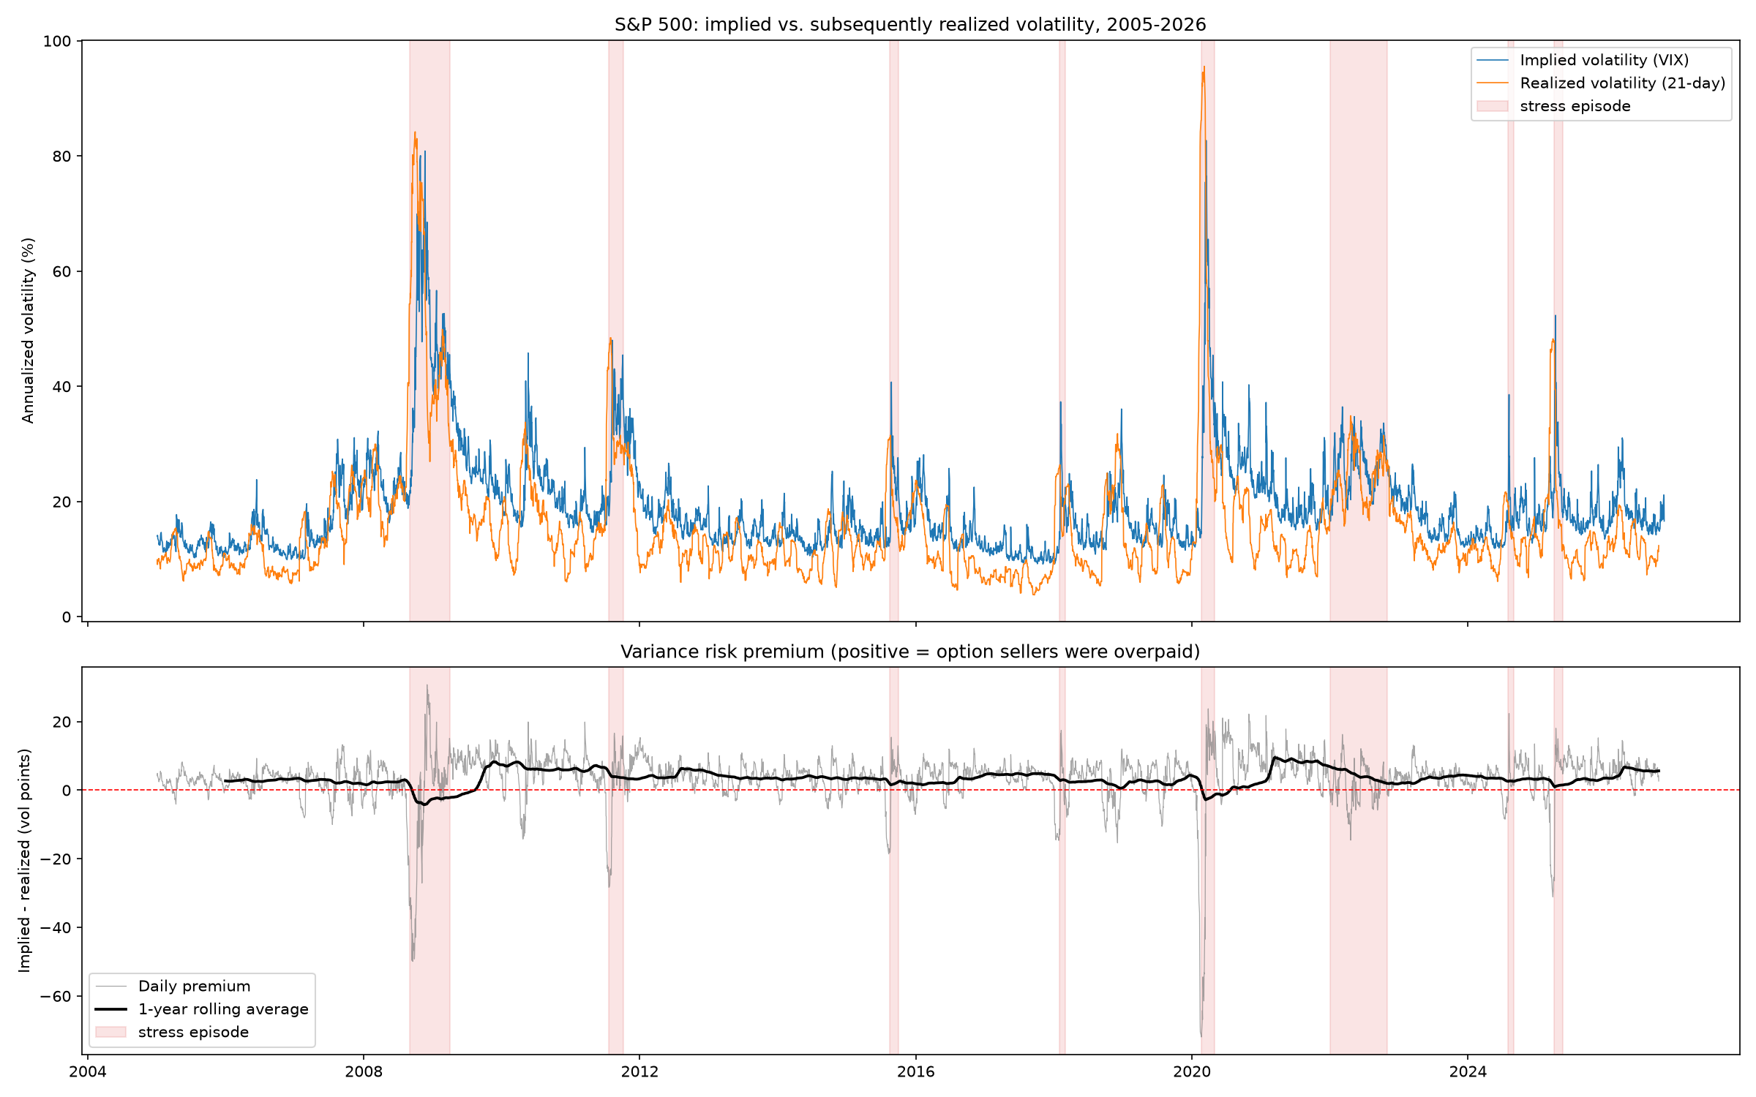
Option buyers pay for crash insurance
THE QUESTION
VIX prices the next 30 days of S&P 500 volatility. When it sits above what follows, option sellers are overpaid.
THE PREMIUM
VIX²/10,000 − realized variance of the next 21 trading days
= the profit of selling a one-month variance swap
Data: S&P 500, VIX, VIX3M (Yahoo Finance) and 3-month T-bill (FRED), Jan 2005 – Nov 2026 · 2
Notes:
VIX is the market’s price for the next 30 days of S&P 500 volatility. In the top panel, blue is VIX and orange is the volatility that actually happened over the next month. Most of the time blue sits above orange: options were priced for more turbulence than came. I measure the gap as VIX squared minus the realized variance over the next 21 trading days. That number is exactly the profit of selling a one-month variance swap, so it is both a statistic and a trade. The bottom panel shows the gap in volatility points: small and positive most days, with deep drops in 2008, 2020 and April 2025. The data runs from January 2005 to November 2026, from Yahoo Finance and FRED.

Slide 3
Sellers usually win
FINDING 1
84%
3.5 pts
of days, VIX was above the volatility that followed
average gap between VIX and realized volatility
82%
215 / 261
of non-overlapping months were profitable for the seller
months positive: a sign test gives p ≈ 2.7 × 10⁻²⁷
Is selling S&P 500 volatility a free lunch? · 3
Notes:
First finding: sellers usually win. VIX was above the volatility that followed on 84% of days, by three and a half vol points on average. Daily observations overlap, so for tests we take one observation every 21 trading days. On those non-overlapping months, 82% were profitable for the seller: 215 of 261. A sign test asks whether that could be a 50/50 coin, and the p-value is about ten to the minus twenty-seven. So the typical month is not luck.

Slide 4
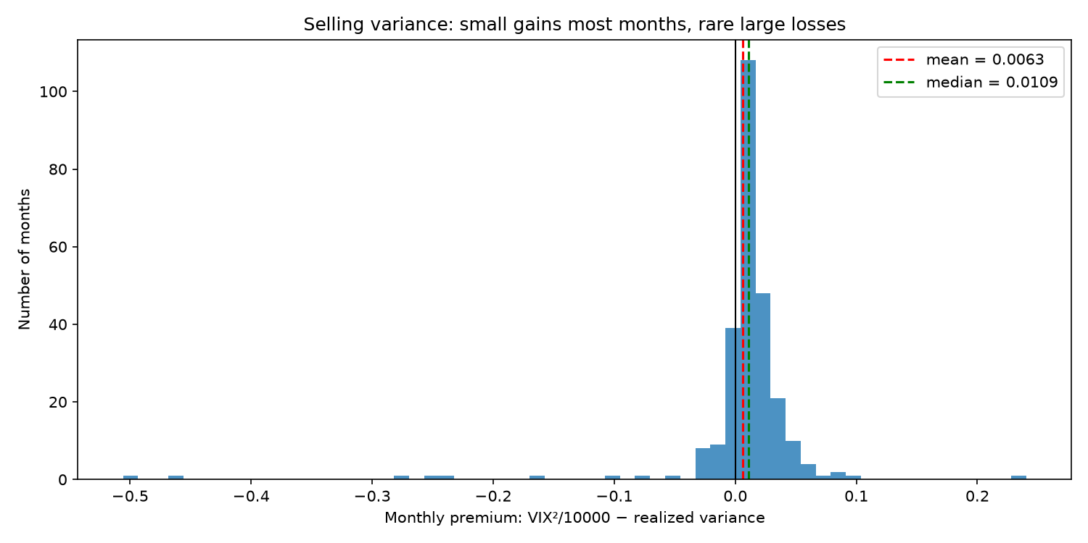
But a few crashes decide the average
FINDING 1, CONTINUED
Skew −5.4
and excess kurtosis 42: a long, fat left tail
46 months
of typical gains erased by March 2020 alone
t = 8.9 → 2.3
naive vs Newey–West; 1.6 to 2.6 on non-overlapping months
Is selling S&P 500 volatility a free lunch? · 4
Notes:
But the average is fragile. This histogram shows the monthly profit of selling one variance swap. Most months are small gains just above zero, and the median is above the mean, because a long left tail drags the mean down. Skew is minus 5.4 and excess kurtosis is 42. One month, March 2020, wiped out about 46 typical months of gains. That matters for inference. Daily observations overlap by 20 of 21 days, so a naive t-test gives t = 8.9. With Newey–West standard errors it falls to about 2.1 to 2.3, and on non-overlapping months it ranges from 1.6 to 2.6 depending on which day of the month we start. So the premium is large and usually positive, but whether the mean is significant depends on how we count a handful of crashes.

Slide 5
Sudden crashes hurt; slow bear markets don’t
FINDING 2
Loss on a one-month variance swap sold on each stress episode’s first day, in vol points
COVID Mar 2020
−72
GFC 2008
−32
US downgrade Aug 2011
−28
Tariff shock Apr 2025
−26
China deval Aug 2015
−18
Volmageddon Feb 2018
−12
Yen carry Aug 2024
−3
2022 bear market
−2: stocks fell 25%, slowly, and VIX had priced it
Source: notebook 02 episode table · Is selling S&P 500 volatility a free lunch? · 5
Notes:
Second finding: what kind of crisis hurts the seller. For each stress episode we sell a one-month variance swap on its first day. It lost money every time. COVID cost 72 vol points, 2008 cost 32, the 2011 US downgrade 28, and the April 2025 tariff shock 26. The contrast is 2022: stocks fell about 25%, but slowly, and VIX had already priced the decline in, so the seller lost only 2 points. August 2024 is similar: VIX spiked to almost 39, but realized volatility stayed near 19%. The lesson is that sellers are paid for bearing sudden jumps the market did not see coming, not for bear markets as such.

Slide 6
VIX forecasts well but is overpriced
FINDING 3
Next-month variance
A rule fixed in advance
Forecast | QLIKE | Bias
VIX² | 0.37 | +0.008
HAR model | 0.39 | +0.002
Last month | 0.57 | 0.000
Test, 2016+ | Always | Rule
Sharpe | 0.36 | 1.20
Worst month | −0.73 | −0.18
Unlucky start | −0.82 | −0.80
Lower QLIKE is better. VIX²’s upward bias is the premium itself.
Sell only if the HAR premium is positive and VIX is below VIX3M. Median of 21 start days; “unlucky start” is the worst one.
The rule avoids the second wave of a crash, not the first hit.
Is selling S&P 500 volatility a free lunch? · 6
Notes:
Third finding: can the premium be timed? We forecast next-month variance with a HAR model, which uses yesterday’s, last week’s and last month’s realized variance, refit every month on past data only. Surprisingly, VIX itself is the better forecast, with lower QLIKE loss, even though it runs about 0.008 too high on average. That bias is the premium. HAR still clearly beats last month’s variance. Then a trading rule: sell only when the HAR forecast premium is positive and the VIX curve is not inverted. We committed the rule to GitHub before testing it on 2016 onwards. Across all 21 possible start days, it keeps the average gain, triples the typical Sharpe ratio and cuts the typical worst month from minus 0.73 to minus 0.18. The catch is the last row: on the unluckiest start day it still takes the COVID loss, because COVID began from calm markets, when the rule was on.

Slide 7
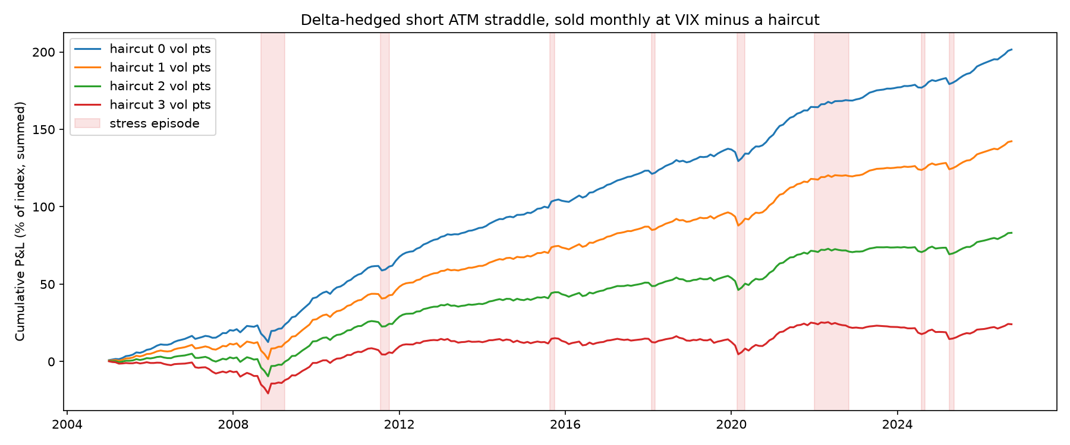
In real options, the edge is thin
FINDING 4
Delta-hedged short ATM straddle, sold monthly since 2005 (P&L in % of the index)
Priced at | Per month | Sharpe | After cost
VIX | +0.77% | 2.1 | +0.66%
VIX − 1 | +0.54% | 1.5 | +0.43%
VIX − 2 | +0.32% | 0.9 | +0.20%
VIX − 3 | +0.09% | 0.3 | −0.02%
0.98
0.47%
correlation of actual P&L with the gamma–theta formula
GBM check: gain from pricing 2 points high (theory: 0.46%)
VIX includes out-of-the-money puts, so ATM options trade a few points below it. The shaded rows are the realistic ones.
Is selling S&P 500 volatility a free lunch? · 7
Notes:
Fourth finding: does the premium survive in options investors can actually trade? Each month we sell a 30-day at-the-money straddle and delta hedge it every day with Black–Scholes. Priced at VIX, it earns 0.77% of the index per month. But VIX includes out-of-the-money puts, so at-the-money options trade a few points below it. Two points below, the gain falls to 0.32% a month, and three points below it is roughly zero after option costs. The hedge behaves as theory says: on simulated GBM paths, pricing two vol points too high earns 0.47% against 0.46% predicted, and on real data the gamma–theta formula tracks the monthly P&L with correlation 0.98. Hedging also softens the tail, but the worst month is still March 2020, at minus 5.8% of the index. With the same trading filter, the Sharpe ratio from 2016 rises from 0.91 to 1.29.

Slide 8
Not a free lunch: it’s insurance underwriting
TAKEAWAYS
Small gains most months, rare losses worth years of gains. Size the position to survive a March 2020.
Limitations
What I learned
VIX overstates ATM option prices (haircuts of 0–3 points)
Only three big crashes in the 2016+ test
No hedge costs, bid–ask, margin or dividends
Straddles enter on the first trading day only
Overlapping data inflated the t-stat four-fold (8.9 vs 2.3)
With heavy tails, the median and the mean disagree
Committing a rule before testing it is what makes the result defensible
Code and data: github.com/Sagar-DU/volatility-risk-premium · 8
Notes:
So, is selling volatility a free lunch? No. It is insurance underwriting: small gains in most months and rare losses worth years of gains, so position size is the whole game. A simple forecast-based filter roughly halves the tail, but it cannot dodge a crash that starts from calm markets. The main limitations: VIX overstates at-the-money option prices, which is why we used haircuts; the test period has only three big crashes; we left out hedge costs, bid–ask spreads, margin and dividends; and the straddles enter only on the first trading day of each month. What we learned: overlapping data can inflate a t-statistic four-fold; with heavy tails the median and the mean tell different stories; and committing a rule before testing it is what makes an out-of-sample claim defensible. The code and data are on GitHub. Thank you.

